Slide 1


FINAL PROJECT
TNSDC -
GENERATIVE AI FOR
ENGINEERING
Presented by
Shwetha C

Slide 2

Project Title
IPL SCORE PREDICTION USING DEEP LEARNING

Slide 3


agenda
1
5
Problem Statement
Solution
2
6
Project Overview
Modelling
3
7
End Users
Results
4
Value Proposition

Slide 4
Problem Statement
Predicting scores in the Indian Premier League (IPL) presents a significant challenge due to the dynamic and unpredictable nature of cricket, where factors like weather conditions, player form, and team strategies play critical roles. Accurate predictions can benefit a wide array of stakeholders including fans, analysts, and betting agencies, enhancing engagement and enabling better decision-making.
Let’s begin!

Slide 5
Project Overview
This project aims to develop a sophisticated deep learning model to predict IPL match scores with higher accuracy than currently available models. Focusing on historical data from IPL seasons 2008-2023, the project will span several key phases, from data collection to model validation, with milestones set for each major task to ensure timely completion.

Slide 6

End Users
The primary beneficiaries of this model will be sports analysts, betting companies, and cricket enthusiasts who seek reliable predictions. The model will cater to their needs by offering enhanced accuracy, easy accessibility, and user-friendly interfaces for interacting with the prediction outputs.
Primary Users: Identify who will primarily benefit from this model (e.g., sports analysts, betting companies, cricket enthusiasts).
User Needs: Describe what these users need in terms of prediction accuracy, usability, and accessibility.

Slide 7
Unlike existing prediction methods that often rely on simpler statistical techniques, this deep learning approach will utilize complex model architectures capable of capturing the intricacies and patterns hidden in cricket data. Unique features of this project include real-time prediction capabilities and the integration of live match data, providing a distinct advantage over traditional methods.
Advantages Over Existing Solutions: Compare the proposed deep learning model with existing prediction methods or models.
Unique Features: Highlight any unique features of your model, such as real-time prediction capabilities or integration with live match data.
Value Propositions

Slide 8

Solution
Our approach involves using advanced deep learning techniques such as Long Short-Term Memory (LSTM) networks and Convolutional Neural Networks (CNNs) to model the score dynamics in IPL matches. We will collect a comprehensive dataset, including detailed match statistics, player performance metrics, and environmental factors, and preprocess it to suit the needs of our model. The development and deployment of the model will utilize state-of-the-art tools like TensorFlow and programming in Python, ensuring that our methodologies are both cutting-edge and robust.

Slide 9
Modelling
The architecture of our deep learning model will be designed to effectively process sequential and spatial data, capturing the temporal dependencies and patterns crucial for accurate score prediction. Training the model will involve rigorous methodologies, ensuring that it learns from a wide variety of game scenarios. Validation and testing will be conducted rigorously to ensure that the model performs well on new, unseen data, providing reliable predictions under various conditions.

Slide 10
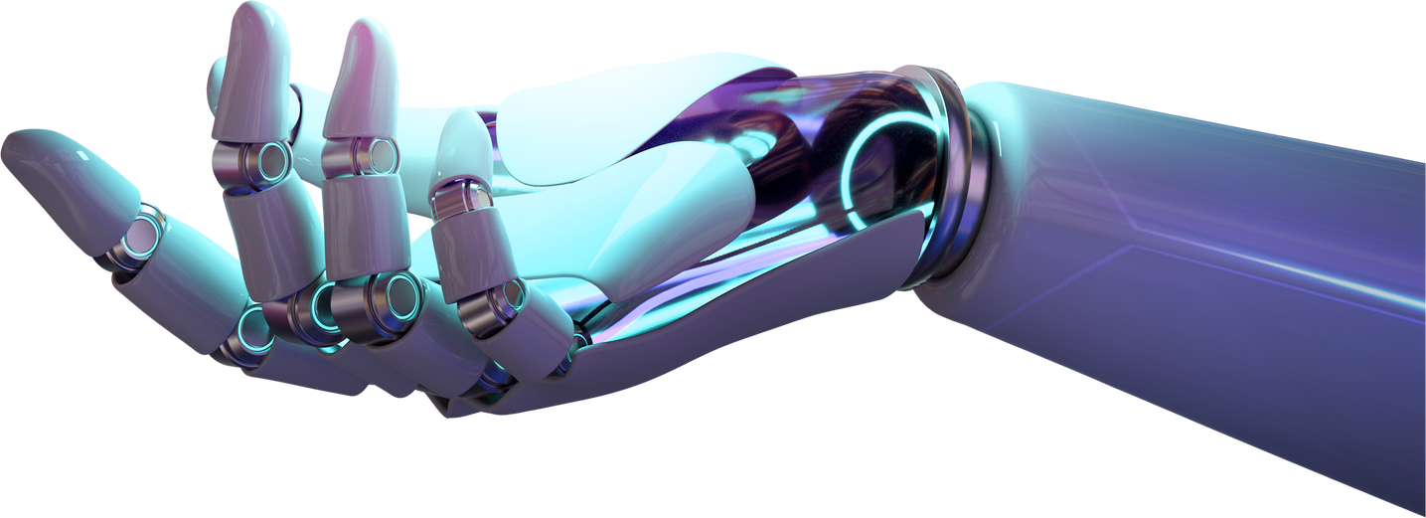
RESULT
To evaluate the performance of our model, we will use metrics such as mean squared error and accuracy. These metrics will help us understand the effectiveness of the model in real-world conditions and guide us in refining its capabilities. Based on the results, we will discuss the implications for end users and outline potential improvements. The project will also consider future enhancements and additional features, like incorporating more granular data or exploring more complex model architectures.

Slide 11
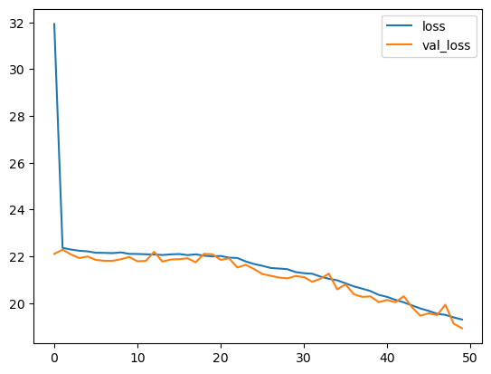
OUTPUT

Slide 12

Thank
you!
GITHUB LINK

